Slide 1
Collection Framework

Slide 2
Collections/Framework
Java.util(java 1.2)-collection API
Java.util-collections framework
Collection and Generic-java 1.5

Slide 3
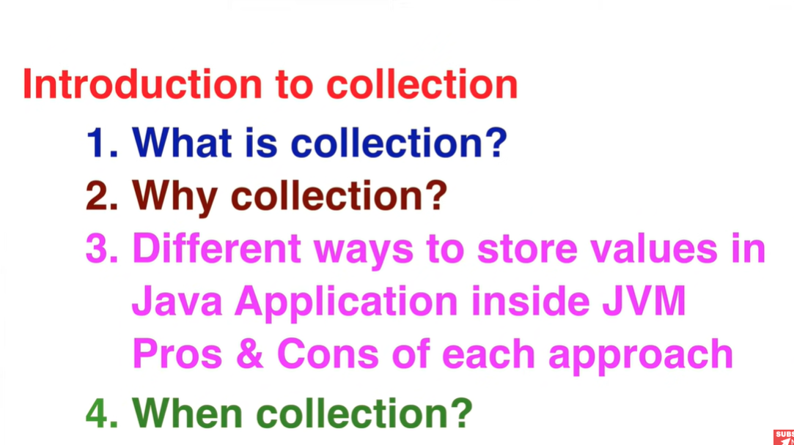

Slide 4
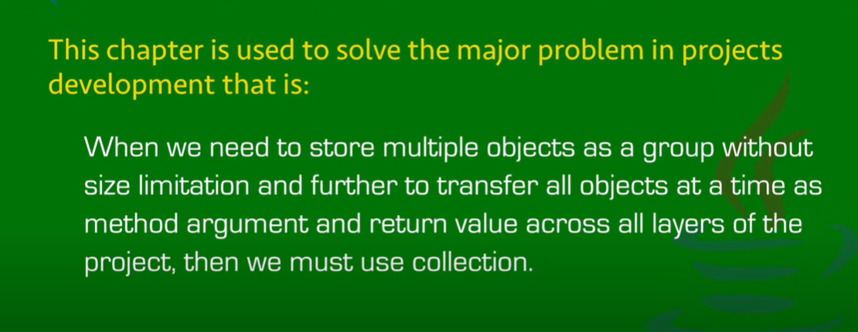
Why is collection?

Slide 5
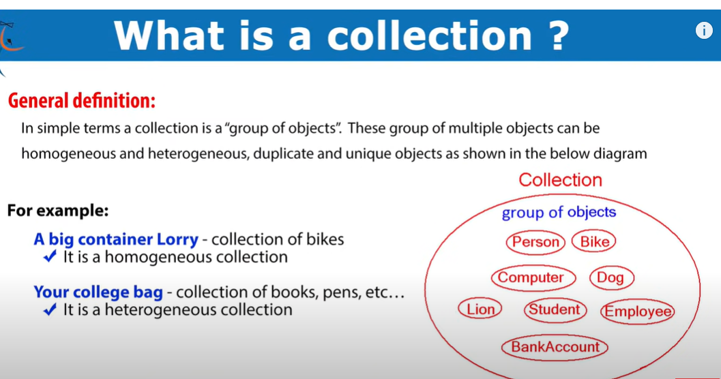

Slide 6
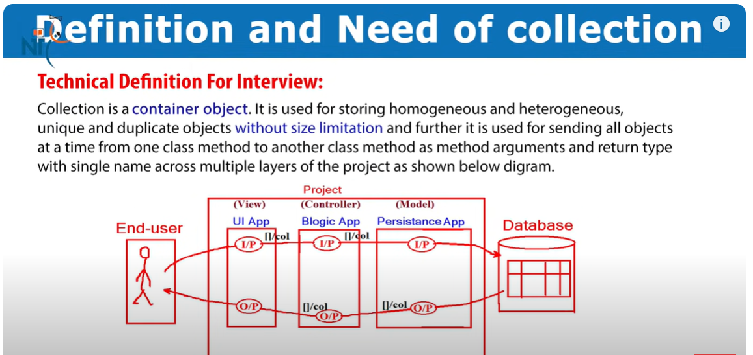

Slide 7
Collections
Collection is group of objects.
But in java collection is also called as an object,(a container object)
So collection is container object.
Objects may be homogeneous and heterogenous
Also unique and duplicate objects are there depending upon data contained.
Without size limitation

Slide 8
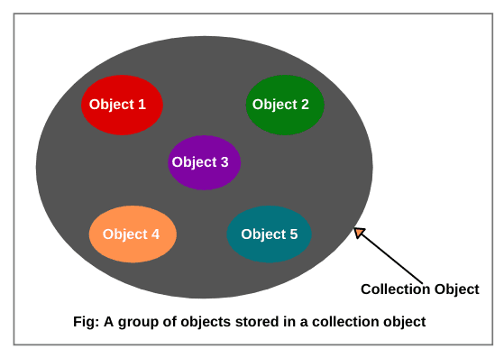

Slide 9
Homogenous objects:
Same class objects are
Heterogenous object:
Different classes objects are

Slide 10
Why collection?
Collection are used to storing multiple objects as a single unit object and sending all objects at a time to one class to another class as a method parameter arguments and return type.
Collection is extension to the existing chapter data types.

Slide 11
Storing data in JAVA( 4 ways):-
1)using variables
2)using class object
3)using array object
4)using collection object

Slide 12
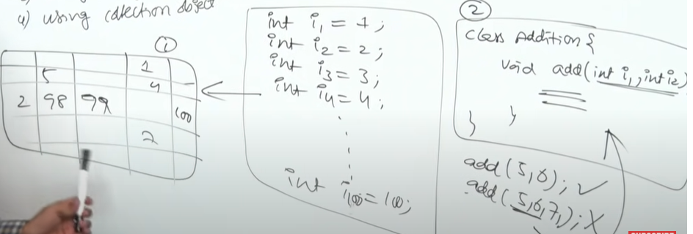
Using variables(problem with reading,sending and return only one value,because we can store only 1 value)

Slide 13
Using class object and array object we can store multiple fixed number of values
Class object-values with different types.
Array object-value with same types.
So, by using collection object we can store multiple objects with same or different type, without size limitation.

Slide 14
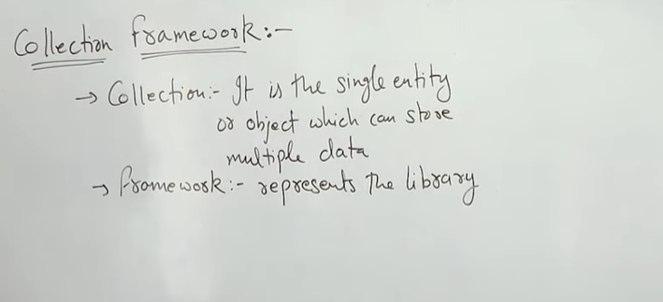
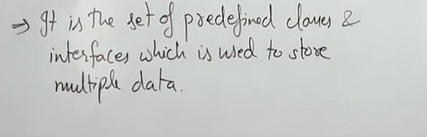
Collection Framework is a API:-

Slide 15
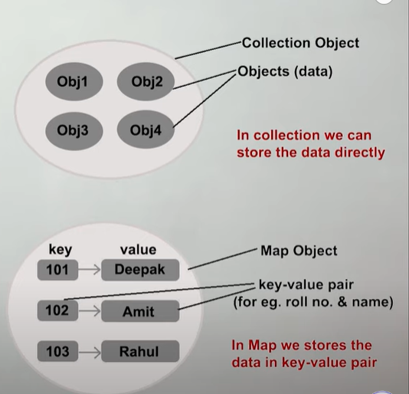
Java.util.Collection;
Java.util.Map;

Slide 16
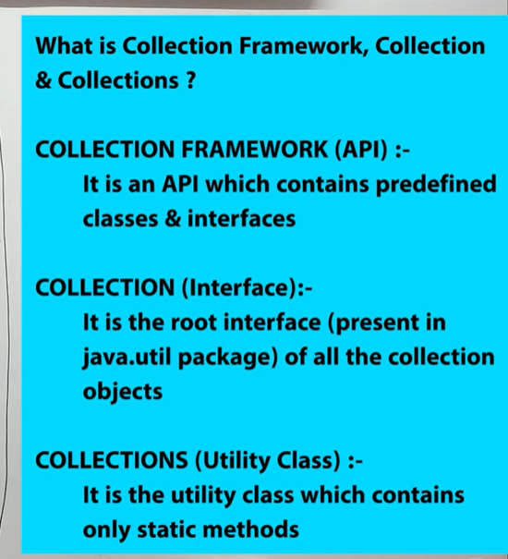

Slide 17
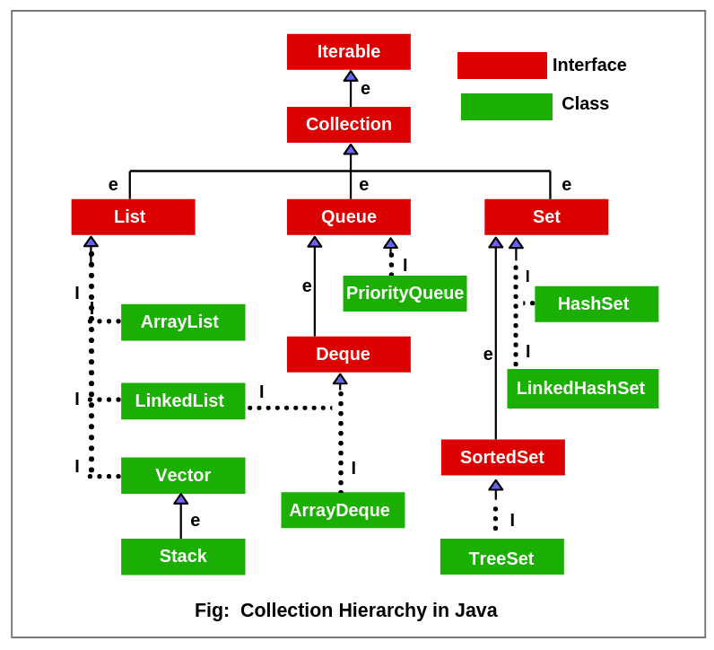

Slide 18
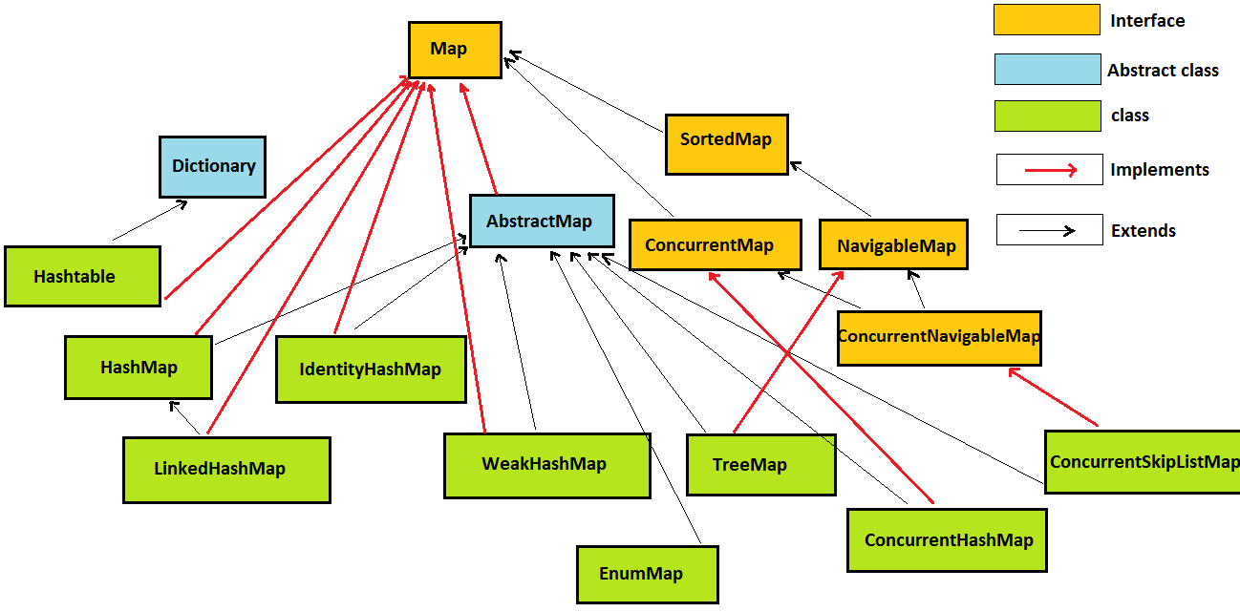
Map Hierarchy

Slide 19
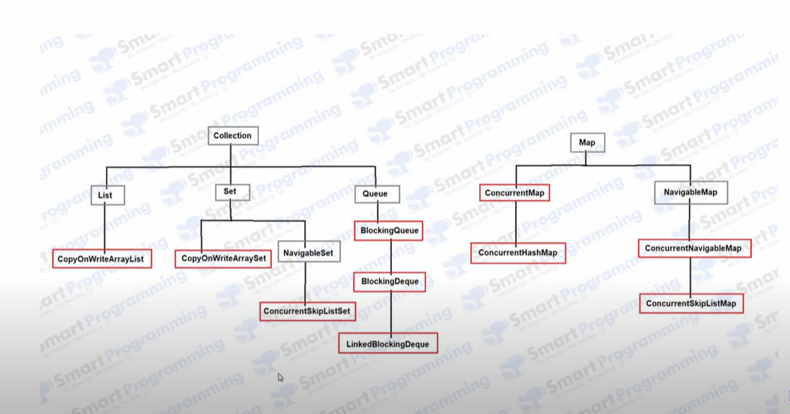

Slide 20
